Slide 1


Create an
Epic SlideShare with this
Template
@twitterhandle
Your logo

Slide 2
Before viewing the template, note…
All Keynote (& PowerPoint) Versions Aren’t Created Equal
There may be design discrepancies based on different software versions, please adjust your deck accordingly. For your reference, I’ve included a PDF of what the slides look like for me.
install the included fonts on your computer
The fonts used in this template aren’t standard use fonts. Install the fonts (from the “Fonts” folder) to ensure that your template looks like mine. Once the fonts are installed, reopen the template. I’ve also included download links to the fonts later in the deck, just in case the included fonts don’t work.

Slide 3
A little note from me to you
This is a guide, you don't have to follow it exactly.
Adjust font sizes based on your deck and content.
Play with different fonts, background colors, images and icons.
Experiment with graphic elements. If there’s one that you like, use it on other slides.
Link to sources you used. If you’re posting your deck on SlideShare, keep the links in center of the slide. SlideShare deactivates links on the far left and right sides due to their built-in “go to the next slide” feature.

Slide 4
Links to help create your presentation
My guide on the 4 Steps to Create Great Presentations
Images: The 13 Ultimate Free Stock Photo Sites for your Presentation or Online Course
Color palette inspiration: ColourLovers.com
Free commercial font downloads: FontSquirrel.com
Font pairing website: TypeGenius.com
Here’s great CreativeBloq article on great type pairings

Slide 5
Design elements needed for this template
Color
Palette
Typography
HEX
#4E0E05
If you don’t have the fonts, install them first.
The main (body) font is Helvetica Neue. It comes in the standard Mac iOS X v10.6 and after. If you don’t have it, it’s included in the “Fonts” folder.
The second font used in the presentation is Garamond. If the included font doesn’t work, download it free from FontSquirrel here.
HEX
#981300
HEX
#E39920
HEX
#E9D8BF
HEX
#5BB0B2

Slide 6
This is where your Awesome
Title Goes
@twitterhandle
Your logo

Slide 7

I’m Author Name.
Image of you here
Position at X Company
@twitterhandle

Slide 8
AGENDA SLIDE HERE
1
Section 1 Title Here
2
Section 2 Title Here
3
Section 3 Title Here
4
Add more sections if needed

Slide 9
Your Section Title Goes Here
1
Your subhead goes here
like…

Slide 10
2
Tips for Designing Slides

Slide 11

Use
captivating
images

Slide 12
Stick to one point per slide

Slide 13
Stick to one point per slide
Use a second slide to add in other related and important information

Slide 14


Try changing the background color, font colors and add in different photos or icons.

Slide 15
Try changing the background color, font colors and add in different photos or icons.
Use elements like the arrow to draw attention to certain notes

Slide 16
Play with font weights, like using bold for important keywords

Slide 17
Play with font weights, like using bold for important keywords
Or use a different color

Slide 18

Experiment with different shapes and text over images to enhance your points

Slide 19
Use a quote or a high impact statement here
“

Slide 20
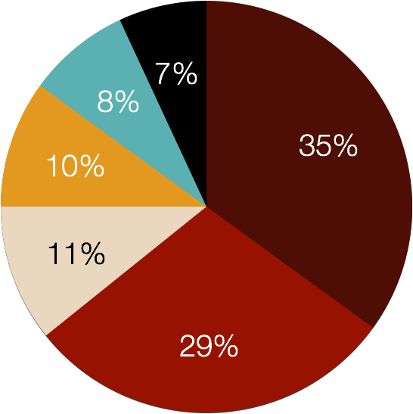
Data: Graph & Charts
61%
52%
37%
18%
2011
2012
2013
2014

Slide 21
THANK YOU!
Share if you liked this deck!
@twitterhandle
Your logo

